Slide 1
What is Perception?
perception is the process by which an agent (such as a robot, human, or any system) gathers and understands information about its environment. This is done by interpreting the data collected from sensors (like cameras, microphones, or other devices that detect environmental inputs).
A self-driving car uses cameras (sensors) to perceive road conditions.

Slide 2
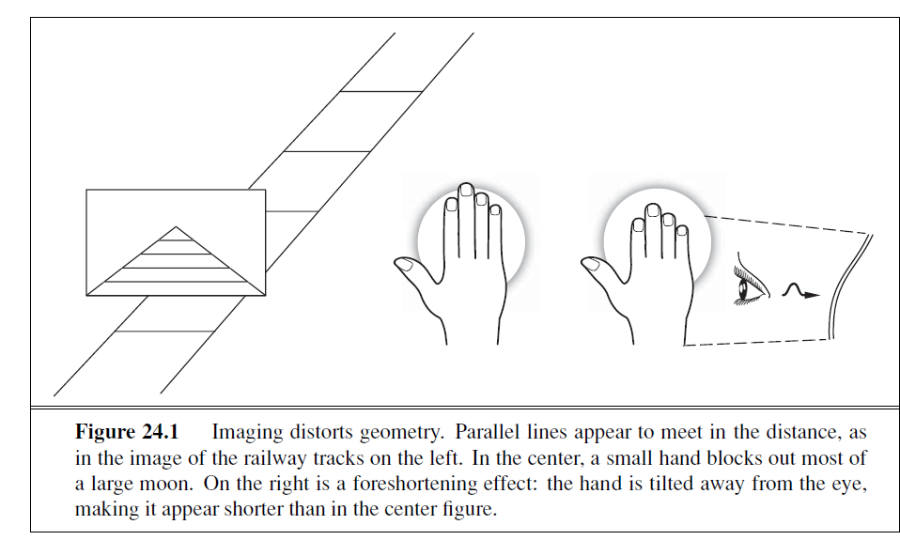
IMAGE FORMATION
Imaging : Technique used to get the appearance of object on various perception
For Example, a picture of long straight railway tracks ,will suggest that the rails converge and meet.
Another example , if you hold your hand in front of eye, you can block out the moon, which is not smaller than your hand.

Slide 3
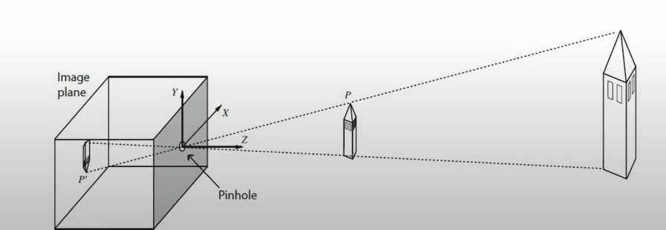
IMAGE WITHOUT LENSES:THE PINHOLE CAMERA
The simplest way to form a focused image is to view stationery objects with a pinhole camera, which consist of the pinhole opening , at the front of the box and image at the back of the box.
Photons must pass through the pinhole, if it is small enough then , the image will be in focus.

Slide 4
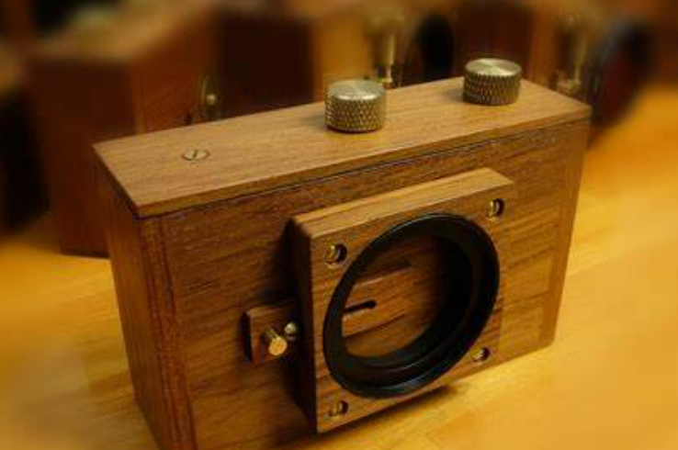
Pinhole Camera
Each light sensitive element in the image plane , at the back of pinhole camera receives light from a small range of directions that passes through the pinhole.
The process of projection means that large, distant objects looks the same as smaller , nearby objects.
Image produced is upside down.

Slide 5
Drawback of Pinhole camera
We need a small pinhole to keep the image in focus.
But with smaller pinhole , less number of photons passes through, meaning the image will be dark.
Objects in the scene that move will appear blurred.

Slide 6
Lens System
Modern cameras use lens system to gather sufficient light while keeping the image in focus.
A large opening is covered with a lens that focuses light from nearby object.
However lens system have a limited depth of field.
Objects out of range will be out of focus in the image.
To move the focal plane, the lens camera move back and forth.

Slide 7
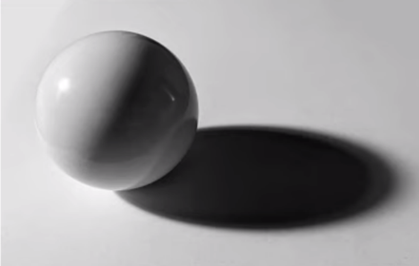

Light and Shading
In the image, the brightness of pixel , is based on the brightness of the surface patch.
The three main causes of varying brightness are:-
Overall Intensity of light
Light Reflection
Shading

Slide 8
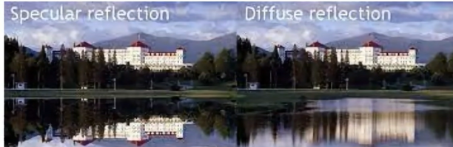
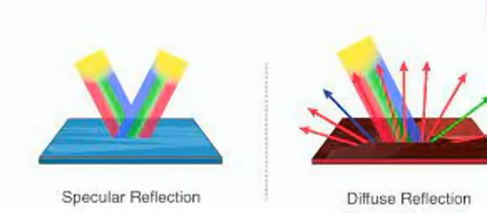
Light and Shading – Diffuse Reflection
Most surfaces reflect light by a process of diffuse reflection.
Diffuse reflection scatters light evenly across the directions leaving a surface.
So the brightness of diffuse surface does not depend upon the viewing direction.
Specular reflection will get mirrored image but diffuse reflection does not.

Slide 9
Light and Shading – Distant point light source
The main source of illumination is the sun, whose rays all travel parallel to one another.
It is very effective in indoor as well as Outdoor scenes.
In this model , the amount of light collected by surface patch, depends on the angle between the illumination direction and normal to the surface.

Slide 10
image recognition
image recognition is a subfield of computer vision which involves the ability of machines to interpret and understand visual information from the
Process of identifying and detecting an object or feature in a digital image or video
Example: self-driving cars, security systems
AI algorithms specifically deep learning algorithms are used to analyze and understand the content of an image these algorithms work by identifying patterns and features in the image and then making a prediction about what the image contains
The image recognition algorithm is trained using a data set of labeled images which allows it to learn how to identify objects and patterns in new images. Neural n/w are used for this purpose, as they can mimic the way the human brain processes visual information.

